Slide 1
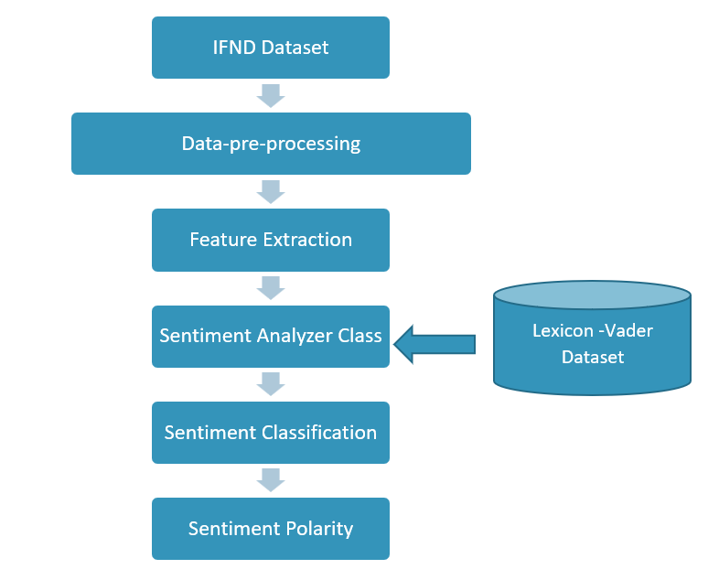
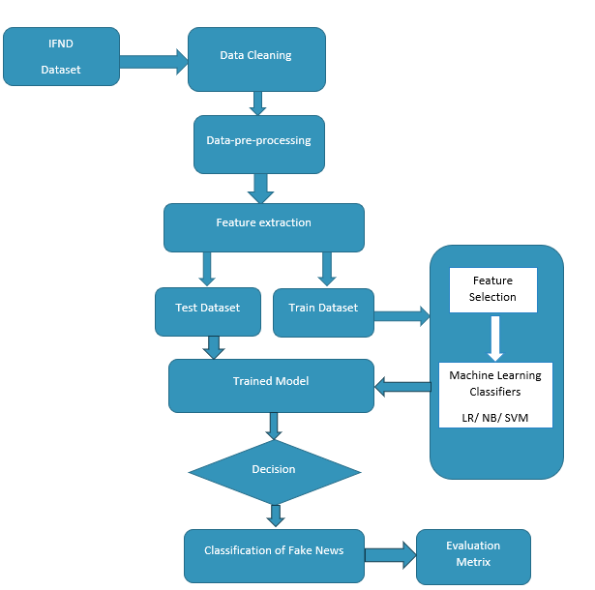
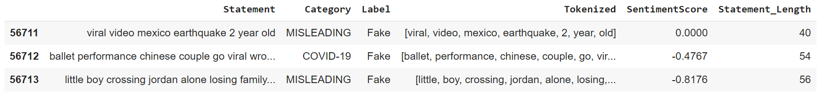

IDENTIFICATION OF FAKE NEWS IN SOCIAL MEDIA USING SENTIMENTAL ANALYSIS
Presented by Jovitha Swena Joseph Wilson
Student ID: 20220603
Supervised by Dr. Seyed Hosseini
ABSTRACT
METHODOLOGY
This research focuses on finding the most effective models that promote detecting fake news from online media platforms. As there is a rapid spread of fake news through online platforms, and it has an impact on the society. The issues caused by fake news are as follows: fake news leads to decisions based on misleading information and can also lead to distrust and separation within society. As there is a correlation between people’s emotion and the virality of fake news. One of the ways to detect this fake news is by, text mining using sentiment analysis. Henceforth, the sentiment polarity using a lexicon-based approach is calculated, and will find out its role in fake news. In addition, the accuracy of Logistic Regression, Naive Bayes and Support Vector Machine which are supervised Machine Learning model for their performance are compared in the detection of fake news in the Indian Fake New Detection dataset. As the result, the role of sentimental score in detecting fake news, and hyper tunning SVM model is the best model compared with the other supervised learning ML model, with an accuracy of 93 %. Overall, this research will provide an automatic system to identify fake news from social media platforms, which is more effective with high accuracy, and to make social media platforms a safe, reliable, and healthy space for future generations.
DESIGN
In this paper, the sentiment of the text using a lexicon-based approach is analyzed, in which the sentiment polarity of the text is calculated, and will find the variants that place an essential role in fake news.
In addition, supervised machine learning algorithm for identifying fake news using sentiment analysis. The accuracy of Logistic Regression, Naive Bayes, and SVM, ML model for its performance in detecting fake news in IFND is compared.
FLOWCHART
Lexicon-Based Sentimental Analysis
OBJECTIVES
The aim of this research is to implement an automatic, more feasible system to detect fake news from social media platforms, and to make social media platforms a safe, reliable, and healthy space for future generations.
To identify the main variants that play a vital role in detecting fake news.
To evaluate the challenges that are faced when using sentimental analysis for the detection of fake news.
To identify the effective models for detection of fake news in large datasets.
To manage fake news to be detected automatically with efficient accuracy in social media.
FOUNDATION LITERATURE
In recent years, many research has been done on fake news as it is one of the growing concerns.
The definition of fake news has been described as disinformation , misinformation and rumours.
Correlation between emotions and fake news has been discussed in detail.
Machine learning models like XGBoost, random forest and Deep Learning models LSTM and BERT are most commonly used techniques for the detection of fake news.
Lexicon-Based approach was used for analysing the sentiments for reviews, feedbacks and tweets.
GAPS
As fake news spread may adopt emerging techniques. It is vital to update and enhance the detection models continuously.
Fake news with respective to Sentimental Polarity; we have calculated sentimental polarity for evaluating the sentiment of the news headline.
DATASET
The dataset used is IFND: a benchmark dataset for fake news detection. It contains news that specifically covers news in India.
It was gathered between the time frame from 2004 to 2021.
It was collected from real-time sources by scraping an Indian fact-checking website. The dataset contains about 56714 news titles in which 37800 headlines are true and 18914 are fake headlines.
This dataset has diverse in various categories, and has articles regarding COVID-19, election, government, misleading, politics, terrorism, trad and violence.
Supervised-Machine Learning Algorithm For Sentimental Analysis
FINDINGS
Evaluation Metrics
 | Accuracy | Precision | Recall | F1_score
LR | 0.9273 | 0.9165 | 0.6281 | 0.7454
NB | 0.9205 | 0.9259 | 0.5773 | 0.7112
SVM | 0.9309 | 0.9229 | 0.6462 | 0.76022
H-SVM | 0.9349 | 0.8809 | 0.7120 | 0.7875
WHITECLIFFE,
LEVEL-3 RANCHHODE HOUSE,
LAMBTON QUAY WELLINGTON,
NEW ZEALAND.

